Slide 1
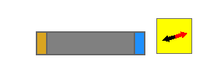
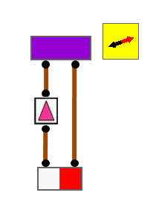
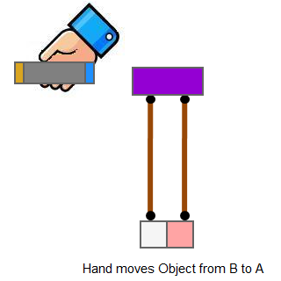
Explore Program1.exe, Program2.exe and Program3.exe.
There are some similarities that can be observed among the three programs.
For example:
From Program 1
Same behaviour observed
What conclusions can you draw?
From Program 2
From Program 3

Slide 2
Your challenge of the day
  Examine the three programs and draw suitable conclusions to link up your observations.
  Make predictions to other setups based on the conclusions you have drawn.

